Slide 1

DEPARTMENT OF ELECTRONICS AND COMMUNICATION ENGINEERING Eco-geological environmental coal mining protection based on wearers’ vital Smart jackets
BATCH NO : 03
BATCH MEMBERS
NAME : A.AKASH (2210811011002)
M.GAURAV (221081101035)
S.GOWTHAM(221081101039)
R.DHINAKARAN(221081101626)
GUIDE NAME
Dr.M.KUMERESAN

Slide 2
ABSTRACT:
The project designs a smart IoT-based helmet and safety jacket to improve safety for coal mining workers by
monitoring environmental and health conditions in real time.
The helmet includes sensors to measure temperature and humidity (DHT11), detect harmful gases like methane
and carbon monoxide (MQ gas sensor), and identify falls or abnormal head movements (IMU sensor).
The jacket contains health-monitoring sensors such as a SpO₂ sensor (oxygen level in blood), body temperature
sensor, and pressure sensor to detect health issues and underground pressure changes.
All data is sent to a remote monitoring system through an IoT microcontroller. If dangerous conditions or health
problems are detected , automatic alerts are sent for immediate rescue action.

Slide 3
INTRODUCTION :
Coal mining remains one of the most dangerous occupations worldwide. Workers are constantly exposed to hazardous gases such as methane (CH₄) and carbon monoxide (CO), oxygen-deficient environments, high temperatures, humidity, and underground pressure variations. In addition, accidents such as roof collapses, falls, and sudden health issues increase the risk of fatal injuries.
Traditional safety systems in coal mines primarily focus on environmental monitoring at fixed locations and do not continuously track individual worker health conditions. This creates a delay in emergency detection and rescue operations.
To overcome these limitations, this project proposes a wearable IoT-based safety monitoring system integrated into a smart helmet and jacket. The helmet includes environmental and motion sensors such as DHT11 (temperature and humidity), gas sensors, and an IMU angle sensor. The jacket integrates health-monitoring sensors, including SpO₂, body temperature, and pressure. All collected data is transmitted in real time to a monitoring station through IoT technology, ensuring immediate detection of unsafe conditions and faster emergency response.

Slide 4
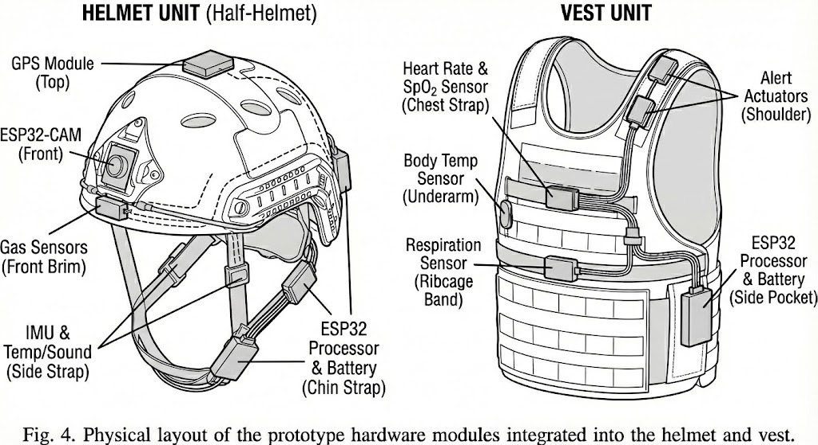

Slide 5
PROBLEM STATEMENT :
Coal mining operations present significant eco-geological and environmental challenges, including land degradation, gas emissions, dust pollution, temperature extremes, and geological instability. These hazardous conditions not only impact the surrounding ecosystem but also expose miners to serious health risks such as respiratory disorders, heat stress, oxygen deficiency, and sudden cardiac events. Although environmental monitoring systems are commonly deployed in mines, they often function independently of workers’ health monitoring, limiting their ability to provide comprehensive, real-time risk assessment and early warning during critical situations.
There is a pressing need for an integrated safety solution that simultaneously monitors environmental parameters and miners’ vital signs. Smart jackets embedded with physiological and environmental sensors can offer continuous tracking of heart rate, body temperature, respiration, blood oxygen levels, and toxic gas concentrations. By combining wearable technology with intelligent data analytics and real-time alert systems, such a solution can enhance worker safety, reduce accident rates, support eco-geological protection efforts, and promote sustainable coal mining practices

Slide 6
OBJECTIVES:
To design a smart helmet equipped with:
DHT11 sensor for temperature and humidity monitoring.
Gas sensor for detecting hazardous gases.
IMU angle sensor for fall detection and abnormal movement detection.
To design a smart jacket equipped with:
SpO₂ sensor for monitoring blood oxygen levels.
Body temperature sensor.
Pressure sensor for underground atmospheric monitoring.
To implement IoT-based real-time data transmission to a remote monitoring system.
To generate automatic alerts during abnormal environmental or health conditions.
To improve overall safety and emergency response time in coal mining environments.

Slide 7
METHODOLOGY :
The proposed methodology for Eco-geological environmental coal mining protection based on wearers’ vital smart jackets begins with the design and integration of a multi-sensor wearable system. The smart jacket and helmet are embedded with environmental sensors (gas, temperature, humidity, and motion/IMU) and physiological sensors (SpO₂, body temperature, and pressure/heart-rate monitoring). These sensors continuously collect real-time data related to both mine conditions and worker health status. The sensed signals are transmitted to a central microcontroller (e.g., ESP32), where data acquisition, filtering, and threshold-based analysis are performed. Predefined safety limits based on mining regulations and medical standards are programmed into the controller to detect hazardous environmental exposure, abnormal vital signs, or fall incidents. When sensor readings exceed safe limits, the system classifies the condition as critical and triggers immediate local alerts. the second stage, the processed data is transmitted through a wireless communication module (Wi-Fi/GSM/LoRa) to a cloud-based monitoring platform or control room dashboard. The cloud system stores historical data, enables real-time visualization, and supports predictive analytics for identifying patterns such as gradual gas accumulation or worker fatigue trends. Supervisors can remotely monitor multiple workers simultaneously and initiate emergency responses when necessary.

Slide 8
LITERATURE REVIEWS
SL.NO. | TITLE | AUTHORS | YEAR | MAJOR FINDING
1. | Multiple Sensor Network (MSN) for Coal Mine Safety Monitoring with LoRa Module | Soumyadeep Ghosh Ayandip Saha Nupur Chhaule | 2024 | The temperature, humidity, gas concentration, vibration of the mine, and other environmental factors can all be recorded by the multiple sensors in one node.
2. | On Underground Coal Mine Environment Monitoring with LoRa Range Extension | Saikat Chandra Bakshi Ankita Pramanik Ramakrishnan Lakshmanan | 2023 | The work also presents a technique to extend the range of LoRa nodes so as to increase the coverage of LoRa network
3 | Design of IOT based coal mine safety system using LoRa | Aruna Manjusha Sudeep Sharma | 2022 | An alert notification is sent to the authorized person's mailbox if a fire breaks out in a coal mine. Temperature and humidity levels are regularly checked and displayed
4. | Operation Technology of Unmanned Mining Robot for Coal Mine Based on Intelligent Control Technology | Chunpeng Li Xingfu Zhang | 2020 | The purpose of this study is to discuss the application of intelligent control technology in coal mine operation, and prove its effect and potential through experiments.

Slide 9
SL.NO. | TITLE | AUTHORS | YEAR | MAJOR FINDING
5. | The Design and Research of Coal Mine Safety Dynamic Evaluation System | Zhang Jiangshi Fu Gui | 2022 | Through this system, mine-related managers can real-time insight into production of underground safety and security trends
6. | Development and Field Application of Ultrasonic Scanner for Coal Mine Gas Extraction Borehole Drilling | Lili Yan Xingming Wang Kai Chen | 2023 | The geological conditions of coal mines in China are complex, the coal industry proposes to adopt the method while drilling to measure the inner diameter of the borehole and the lithological distribution of the strata during the drilling process
7. | Design and Implementation of Coal Mine Equipment Management System | Wei Li Jin Xu ZhenMing Zhang | 2024 | This paper analyzes the main requirements of coal mine electromechanical equipment management, designs a business process for cross-departmental
8. | Optimization scheduling of integrated coal mine energy systems based on multi-objective particle swarm optimization | Fei Ge Xuhui Bu Yanling Yin | 2024 | Firstly, it focuses on the establishment of coal mine integrated energy system models and the utilization of associated and renewable energy sources

Slide 10
SL.NO. | TITLE | AUTHORS | YEAR | MAJOR FINDING
9. | Design of Information Application System for Coal Mine Safety Supervision and Inspection | Jialan Sun | 2021 | Based on the already constructed remote supervision and inspection system for work safety in the Internet of Things
10. | Design of Coal Mine Electrical Control System under Soft Start Technology | Yuanjin Kou Yilong Liu | 2023 | The application of soft start technology can not only realize the high-speed operation and structure of coal mine system
11. | Business Diversification of Coal Mining Enterprises Based on the Development of Coal Mine Methane Utilization Infrastructure | Fedor S. Nepsha Roman V. Kostomarov | 2022 | Within the framework of the study 3 options of coal mine methane utilization were considered: the use of gas genset for generation of electrical and thermal energy (cogeneration)
12. | Navigation System of Coal Mine Rescue Robot Based on Virtual Reality Technology | Zenghui Liu | 2022 | Hector-SLAM algorithm and Cartographer-SLAM algorithm, the test scenes are constructed through virtual reality technology

Slide 11
EXISTING SYSTEM:
In traditional coal mining environments, safety monitoring systems mainly focus on fixed environmental monitoring stations installed at specific underground locations.
These systems typically measure parameters such as gas concentration, temperature, and humidity using stationary sensors.
However, they do not continuously monitor individual workers’ health conditions. In many cases, if a worker moves away from a fixed monitoring area or enters a remote tunnel, hazardous conditions such as methane leakage, carbon monoxide exposure, or oxygen deficiency may go undetected.
Additionally, traditional systems lack fall detection and real-time physiological monitoring such as SpO₂ and body temperature. Emergency response is often delayed because supervisors may not immediately know the exact condition or status of the worker.
Therefore, existing systems are limited in providing comprehensive, real-time, and personalized safety monitoring for coal mining laborers.

Slide 12
PROPOSED METHOD:
The proposed system introduces a wearable IoT-based smart safety solution integrated into a helmet and jacket for coal mining workers.
The helmet unit includes a DHT11 sensor for temperature and humidity monitoring, a gas sensor (MQ series) for detecting toxic gases, and an IMU sensor (MPU6050) for detecting tilt angle and fall conditions.
The jacket unit incorporates a SpO₂ sensor (MAX30100/MAX30102) to monitor blood oxygen levels, a body temperature sensor, and a pressure sensor (BMP280) to detect underground atmospheric changes.
All sensors are connected to a central microcontroller such as ESP32, which processes the data and compares it with predefined safety thresholds.
The system transmits real-time data to a cloud platform or monitoring station via IoT communication.
In case of abnormal conditions—such as high gas levels, low oxygen saturation, excessive temperature, or fall detection—the system triggers immediate alerts through a buzzer and sends notifications to supervisors.

Slide 13
BLOCK DIAGRAM DESCRIPTION:
The block diagram of the proposed system consists of five main sections: sensor unit, microcontroller unit, communication module, alert system, and monitoring system.
The sensor unit is divided into two parts: helmet sensors (DHT11, gas sensor, and IMU) and jacket sensors (SpO₂, body temperature, and pressure sensor). These sensors continuously collect environmental and physiological data and send the signals to the microcontroller (ESP32).
The microcontroller acts as the central processing unit, analysing and comparing sensor readings with predefined safe limits.
The communication module, integrated with Wi-Fi or GSM, transmits real-time data to a cloud server or control room monitoring system. The alert system includes a buzzer and LED indicators that activate when unsafe conditions are detected. Finally, the monitoring system displays worker data on a dashboard, enabling supervisors to track safety parameters and take immediate action during emergencies.
This structured flow ensures real-time monitoring, rapid decision-making, and enhanced protection for coal mining workers.

Slide 14
BLOCK DIAGRAM:
POWER
ESP32
Jacket
DHT11
SPO2
TEMP
HELMET
MQ6
IMU MEMS
RESPIRATORY
LCD

Slide 15
HARDWARE REQUIREMENT:
ESP32 / ESP8266 Microcontroller
DHT11 Temperature & Humidity Sensor
MQ-2 or MQ-7 Gas Sensor
MPU6050 IMU Sensor
MAX30100 / MAX30102 SpO₂ Sensor
DS18B20 / LM35 Temperature Sensor
BMP280 Pressure Sensor
Buzzer
Rechargeable Li-ion Battery
Resistors and connecting wires
PCB / Breadboard

Slide 16
SOFTWARE REQUIREMENTS:
Arduino IDE
Embedded C / C++ Programming
IoT Cloud Platform
Serial Monitor for debugging.

Slide 17
ADVANTAGES:
Real-time monitoring of both environmental and health parameters.
Early detection of toxic gases and oxygen deficiency.
Fall detection using IMU sensor.
Immediate alert system reduces rescue time.
Portable and wearable design.
Cost-effective compared to large industrial monitoring systems.
Scalable for multiple workers.

Slide 18
DISADVANTAGES:
Dependence on network connectivity.
Sensor calibration required for accurate readings.
Battery life limitations.
Initial installation and setup cost.
Wearable comfort considerations.

Slide 19

RESULT:
The system continuously monitors the worker’s vital parameters and surrounding environmental conditions in real time. Whenever abnormal conditions such as high gas concentration, low oxygen level, or increased body temperature are detected, the system immediately generates alerts to both the worker and the control room, allowing quick preventive measures. The results demonstrated that the smart jacket effectively detected hazardous gases such as methane and carbon monoxide, which are common causes of mining accidents and explosions. Additionally, geological sensors such as vibration and tilt sensors successfully identified early signs of rock falls, mine collapse, and structural instability

Slide 20
CONCLUSION:
The proposed wearable IoT-based safety system for coal mining workers provides an effective and reliable solution to enhance occupational safety in hazardous underground environments. By integrating environmental monitoring sensors such as DHT11 (temperature and humidity), MQ-series gas sensors, and MPU6050 IMU sensors in the helmet, along with physiological monitoring sensors such as MAX30100/MAX30102 SpO₂ sensor, body temperature sensor, and BMP280 pressure sensor in the jacket, the system ensures comprehensive real-time monitoring of both workplace conditions and worker health.
The use of an ESP32 microcontroller with IoT connectivity enables continuous data transmission to a remote monitoring station or cloud platform. In emergencies such as toxic gas leakage, oxygen deficiency, abnormal body temperature, or fall detection, the system generates immediate alerts, thereby reducing rescue time and preventing fatal accidents. Compared to traditional fixed monitoring systems, this wearable solution offers personalised safety tracking, mobility, and improved responsiveness.
Overall, the proposed system enhances safety standards in coal mining industries and provides a scalable, cost-effective, and technologically advanced approach to protecting mining labourers. Future integration with AI-based predictive systems and advanced communication technologies can further improve the effectiveness and reliability of the system.

Slide 21
REFERENCE PAPER:
International Labour Organization (ILO), “Safety and Health in Coal Mines,” ILO Guidelines, Geneva.
World Health Organization (WHO), “Occupational Health and Safety in Hazardous Environments,” WHO Reports.
S. R. Deivasigamani et al., “IoT Based Smart Helmet for Coal Miners Safety,” International Journal of Engineering Research & Technology (IJERT), 2019.
A. Kumar and G. P. Hancke, “Energy Efficient Environment Monitoring System Based on Wireless Sensor Networks,” IEEE Sensors Journal, 2014.
L. K. Sharma et al., “Real-Time Gas Monitoring System for Underground Mines Using IoT,” International Journal of Advanced Research in Computer and Communication Engineering (IJARCCE), 2018.

